Slide 1
Remote Procedure Call - Performance
Lecture-12

Slide 2
UNIT-2: Communications in Distributed Systems
Basics of Communication Networks
Layered Protocols
ATM Models
Client-Server Models
Blocking and Non-Blocking Primitives
Buffered and Un-Buffered Primitives
Reliable and Unreliable Primitives
Messagepassing
Remote Procedure Calls

Slide 3
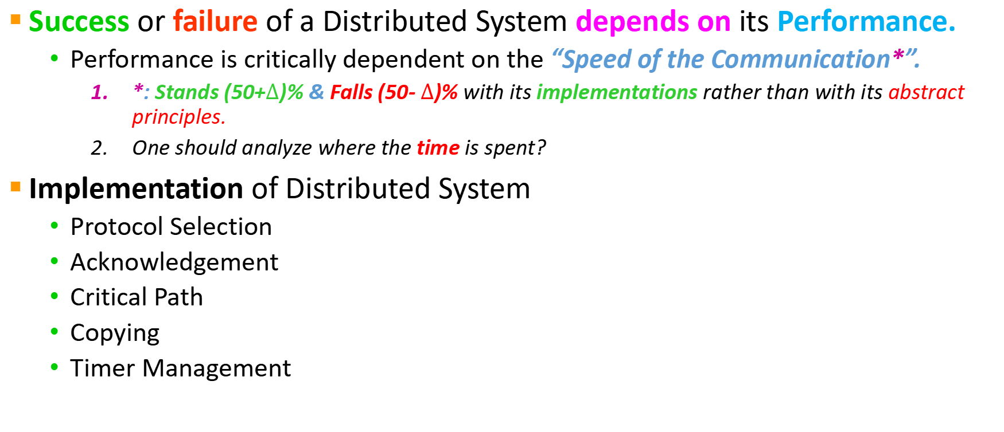
#9: Remote Procedure Call - Performance
Success or failure of a Distributed System depends on its Performance.
Performance is critically dependent on the “Speed of the Communication*”.
*: Stands (50+$∆$)% & Falls (50- $∆$)% with its implementations rather than with its abstract principles.
One should analyze where the time is spent?
Implementation of Distributed System
Protocol Selection
Acknowledgement
Critical Path
Copying
Timer Management

Slide 4
#9.1:RPC Protocol Selection
Criteria of Selection: It should gets the bits from the client’s kernel to the server’s kernel
Connection-oriented protocol vs Connectionless protocol
Standard general-purpose protocol vs Specifically designed for RPC
Length of Packet and Message

Slide 5
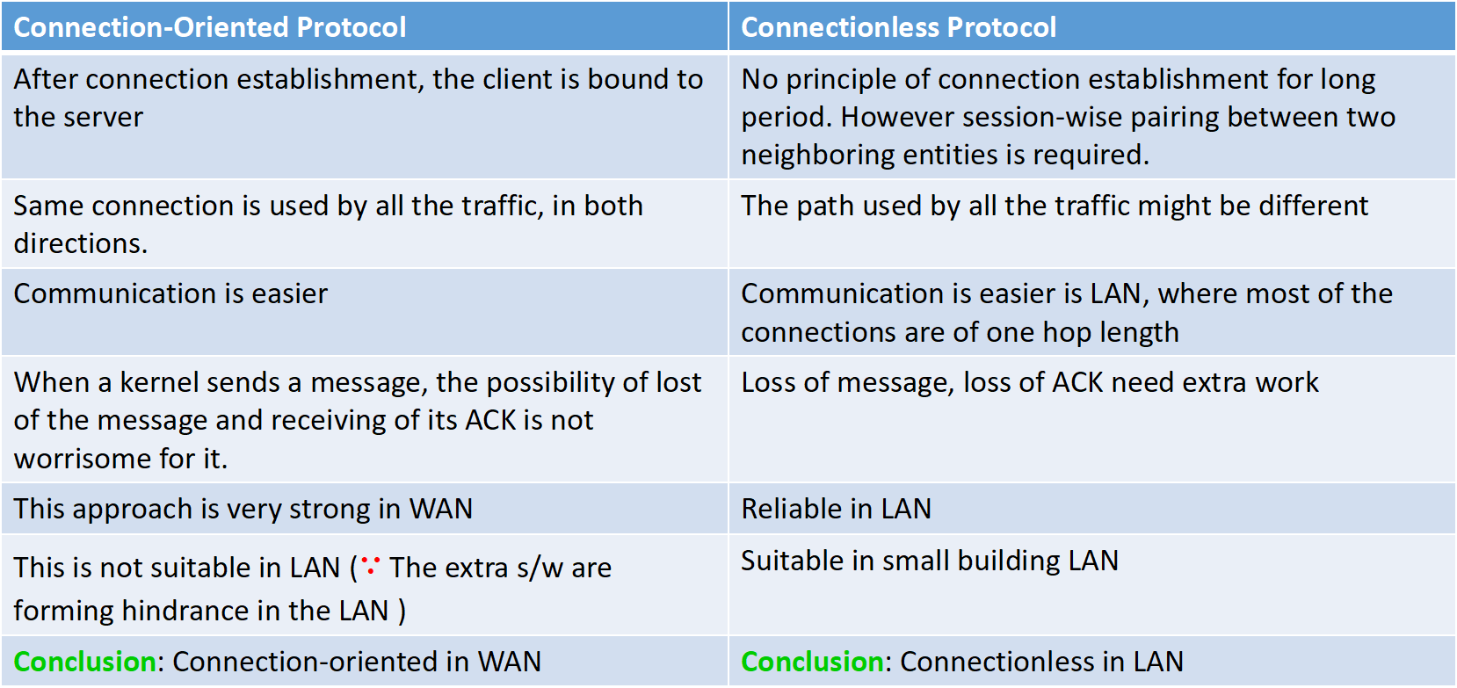
#9.1.1:Connection-oriented Vs Connectionless Protocol
Connection-Oriented Protocol | Connectionless Protocol
After connection establishment, the client is bound to the server | No principle of connection establishment for long period. However session-wise pairing between two neighboring entities is required.
Same connection is used by all the traffic, in both directions. | The path used by all the traffic might be different
Communication is easier | Communication is easier is LAN, where most of the connections are of one hop length
When a kernel sends a message, the possibility of lost of the message and receiving of its ACK is not worrisome for it. | Loss of message, loss of ACK need extra work
This approach is very strong in WAN | Reliable in LAN
This is not suitable in LAN ($∵$ The extra s/w are forming hindrance in the LAN ) | Suitable in small building LAN
Conclusion: Connection-oriented in WAN | Conclusion: Connectionless in LAN

Slide 6
#9.1.2:Standard Protocol Vs Specialized RPC
Standard Protocol (IP or UDP) | Specialized RPC
The protocol is already designed. Saves substantial work. | It is need to be invented, implemented, tested and embedded in existing systems. Considerably more work.
Many implementations are available. Saves work and time. | More work and time
Communication is easier | Communication need to be tested in the networks.
Most of the UNIX systems accept the packets of these protocol for communication purpose | Needs integration into existing UNIX systems
Existing networks also support IP and UDP packets | Need to be tested across all types of networks
Writing, executing and testing code using these protocols are straightforward. | Several phases of software testing is required.
IP is not an end-to-end protocol. It is executed on top of reliable TCP. So, it bounce back several times in the network. | Specialized RPC would avoid bouncing back of the packets.
IP has 13 header fields. 3 are essential (Src_Addr, Dstn_addr, Pkt_len). Header checksum is time consuming | Number of header fields may differ, according to the requirement of the problem.

Slide 7
#9.1.3:Packet and Message Length
Doing an RPC has a large, fixed overhead, independent of the amount of the data sent.
Thus, reading a 64K file in a single 64K RPC is more efficient than reading it in 64 1K RPCs.
It is therefore important that the protocol and network allow large transmissions.
Large size file with Maxflow should be supported by both protocol and network
Sun Microsystem’s limit is 8K (System level constraints)
Ethernet’s limit is 1536 bytes (Network level constraints)

Slide 8
#9.2:Acknowledgements
When large RPCs have to be broken up into many small packets, then what should be the acknowledgement process?
Should individual packets be acknowledged? (stop-and-wait- protocol)
Acknowledge after receiving all the packets (Blast Protocol)
*******
*******

Slide 9
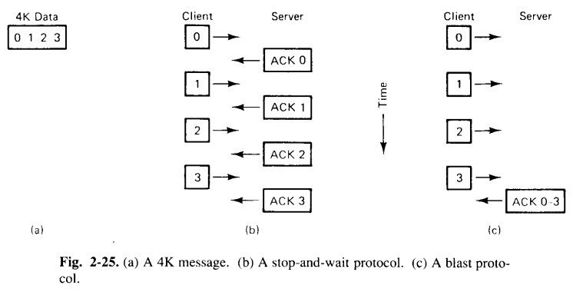
Cont..

Slide 10
Cont..
Suppose a client want to write a 4K block of data to a file server, but the system cannot handle packets larger than 1K.
The message will be divided int 4 1K size of packets (P0-P3).
In the Stop-and-wait protocol, the client will send P0, then waits for an acknowledgement from the server.
Then the client sends the second packet i.e. P1, waits for another acknowledgement, and so on.
In the Blast protocol the client will send all the packets as soon as possible.
The server acknowledges the entire message when all the packets have been received.

Slide 11
Stop-and-Wait
Receiver: send an acknowledge (ACK) back to the sender upon receiving a packet (frame)
Sender: excepting first packet, send a packet only upon receiving the ACK for the previous packet
Sender
Receiver
frame
ACK
Time
frame
ACK

Slide 12
What Can Go Wrong?
Sender
Receiver
Sender
Receiver
Sender
Receiver
frame
frame
frame
Timeout
Timeout
ACK
Timeout
ACK
frame
frame
frame
ACK
ACK
ACK
Frame lost → resent it
on Timeout
ACK lost → resent packet
Need a mechanisms to
detect duplicate packet
ACK delayed → resent packet
Need a mechanism to differentiate
between ACK for current
and previous packet

Slide 13
Stop-and-Wait Disadvantage
May lead to inefficient link utilization
Example: assume
One-way propagation = 15 ms
Bandwidth = 100 Mbps
Packet size = 1000 bytes → transmit = (8*1000)/10⁸ = 0.08ms
Neglect queue delay → Latency = approx. 15 ms; RTT = 30 ms
Propagation = 15 ms
Bandwidth = 100 Mbps

Slide 14
Stop-and-Go Disadvantage cont.
Send a message every 30 ms → Throughput = (8*1000)/0.03 = 0.2666 Mbps
Thus, the protocol uses less than 0.3% of the link capacity!
Sender
Receiver
frame
30 ms
ACK
frame
30 ms
ACK

Slide 15
How to Keep the Pipe Full?
Send multiple packets without waiting for first to be acked
Number of pkts in flight = window
Reliable, unordered delivery
Several parallel stop & waits
Send new packet after each ack
Sender keeps list of unack’ed packets; resends after timeout
Receiver same as stop & wait
How large a window is needed?

Slide 16
Cont..
With stop and wait protocol, if a packet is damaged or lost, the client fails to receive an acknowledgement on time, so it retransmits the one bed packet.
With the blast protocol, the server is faced with a decision when, say, Packet 1 is lost but Packet 2 subsequently arrives correctly.
It can abandon everything, waiting for the client to timeout out and retransmit the entire message.
Or alternatively, it can buffer Packet 2 (along with 0), hope that Packet 3 comes in correctly, and then specifically ask the client to send it Packet 1. This technique is called Selective repeat.
Along with error control, another major point of concern is flow control.
Many network interface chips are able to send consecutive packets with almost no gap between them, but they are not always able to receive an unlimited number of back to back packets due to finite buffer capacity on chip.

Slide 17
Cont..
With some designs, a chip cannot even accept two back to back packets because after receiving the first one the chip is temporarily disabled during the packet-arrived interrupt, so it misses the start of the second one.
When a packet arrives and the receiver is unable to accept it, an overrun error occurs and the incoming packet is lost.
With stop-and-wait protocol, overrun errors are impossible.
With the blast protocol, receiver overrun is a posssibility. To deal with overrun error in blast protocol, the following mechanism can be used:
If, on the one hand, the problem is caused by the chip being disabled temporarily while it is processing an interrupt, a smart sender can insert a delay between packets to give the receiver just enough time to generate the packet-arrived interrupt and reset itself.
If the required delay is short, the sender can just loop (busy waiting); if it is long, it can set up a timer interrupt and do something else while waiting.
If it is in between, probably the best solution is busy waiting.
If, on the other hand, the overrun is caused by the finite buffer capacity of the network chip, say n packets, the sender can send n packets, followed by a substantial gap.

Slide 18
Sliding Window Protocol: Sender
Each packet has a sequence number
Assume infinite sequence numbers for simplicity
Sender maintains a window of sequence numbers
SWS (sender window size) – maximum number of packets that can be sent without receiving an ACK
LAR (last ACK received)
LFS (last frame sent)
Acknowledged packets
Packets not acknowledged yet
LAR
LFS
seq. numbers

Slide 19
Example
Assume SWS = 3
Sender
Receiver
1
frame 1
frame 2
1
2
3
frame 3
ACK 1
1
2
3
1
2
3
4
ACK 2
frame 4
1
2
3
4
5
frame 5
Note: usually ACK contains the sequence number of the first packet in
sequence expected by receiver

Slide 20
Sliding Window Protocol: Receiver
Receiver maintains a window of sequence numbers
RWS (receiver window size) – maximum number of out-of-sequence packets that can received
LFR (last frame received) – last frame received in sequence
LAF (last acceptable frame)
LAF – LFR <= RWS

Slide 21
Sliding Window Protocol: Receiver
Let seqNum be the sequence number of arriving packet
If (seqNum <= LFR) or (seqNum >= LAF)
Discard packet
Else
Accept packet
ACK largest sequence number seqNumToAck, such that all packets with sequence numbers <= seqNumToAck were received
Packets in sequence
Packets out-of-sequence
LFR
LAF
seq. numbers

Slide 22
Sender/Receiver State
Sender
Receiver
Max ACK received
Next seqnum
Next expected
Max acceptable
…
…
…
…
Sender window
Receiver window
Sent & Acked
Sent Not Acked
Received & Acked
Acceptable Packet
OK to Send
Not Usable
Not Usable

Slide 23
Sequence Numbers
How large do sequence numbers need to be?
Must be able to detect wrap-around
Depends on sender/receiver window size
E.g.
Max seq = 7, send win=recv win=7
If pkts 0..6 are sent succesfully and all acks lost
Receiver expects 7,0..5, sender retransmits old 0..6!!!
Max sequence must be ≥ send window + recv window
Notes:
Xxx picture

Slide 24
Cumulative ACK + Go-Back-N
On reception of new ACK (i.e. ACK for something that was not acked earlier)
Increase sequence of max ACK received
Send next packet
On reception of new in-order data packet (next expected)
Hand packet to application
Send cumulative ACK – acknowledges reception of all packets up to sequence number
Increase sequence of max acceptable packet

Slide 25
Loss Recovery
On reception of out-of-order packet
Send nothing (wait for source to timeout)
Cumulative ACK (helps source identify loss)
Timeout (Go-Back-N recovery)
Set timer upon transmission of packet
Retransmit all unacknowledged packets
Performance during loss recovery
No longer have an entire window in transit
Can have much more clever loss recovery

Slide 26
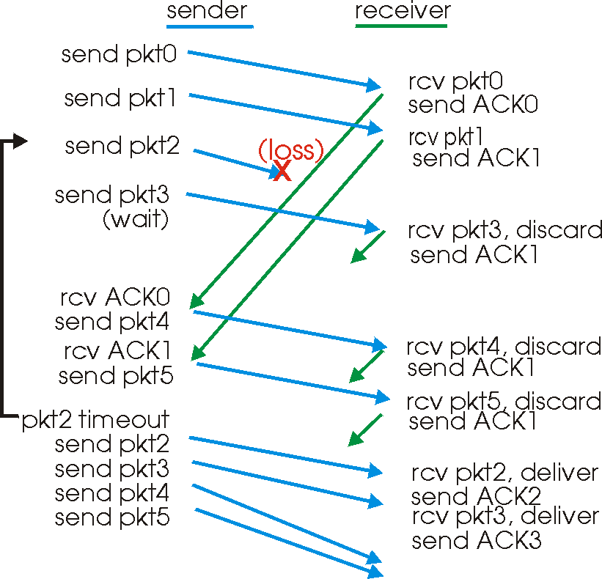
Go-Back-N in Action

Slide 27
Selective Ack + Selective Repeat
Receiver individually acknowledges all correctly received pkts
Buffers packets, as needed, for eventual in-order delivery to upper layer
Sender only resends packets for which ACK not received
Sender timer for each unACKed packet
Sender window
N consecutive seq #’s
Again limits seq #s of sent, unACKed packets

Slide 28
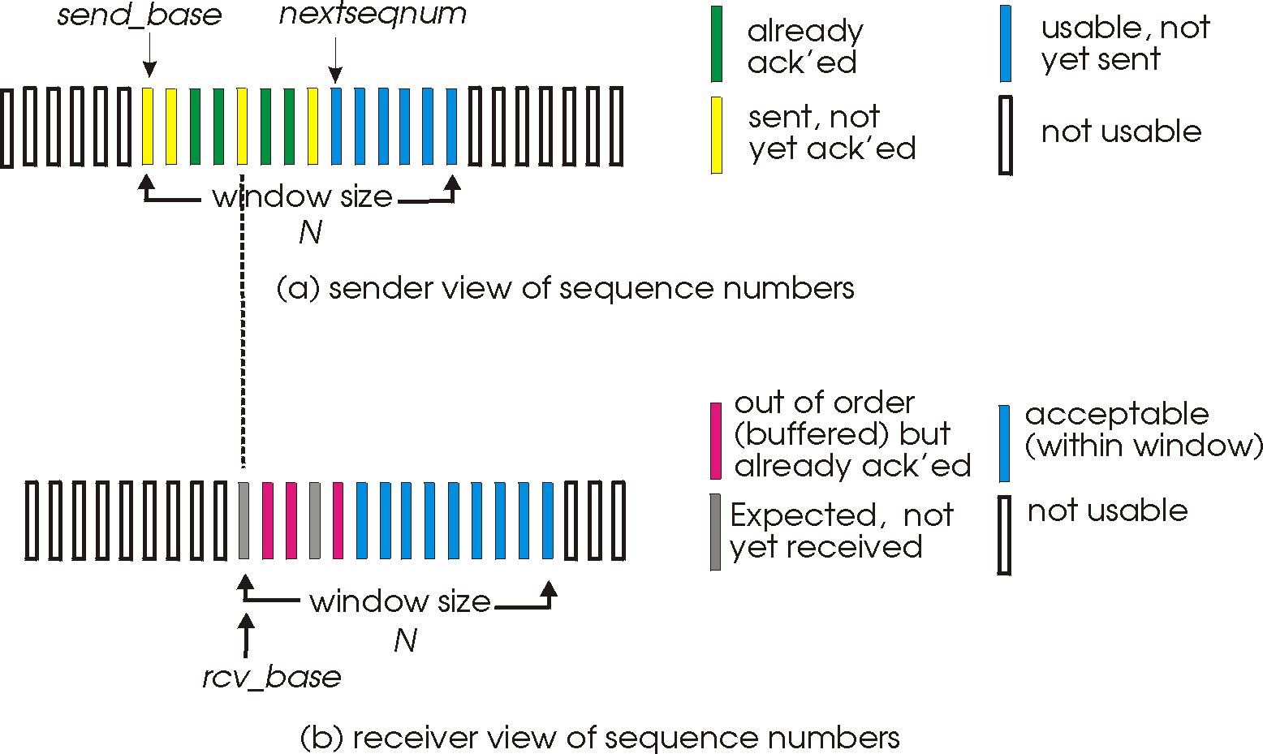
Selective Repeat: Sender, Receiver Windows

Slide 29
Summary of ARQ Protocols
Mechanisms:
Sequence number
Timeout
Acknowledgement
Sender window: fill the pipe
Receiver window: handle out-of-order delivery

Slide 30
Many Nuances
What type of acknowledgements?
Selective acknowledgement
Cumulative acknowledgement
Negative acknowledgement
How big should be the timeout value, Sliding Window Size (SWS), Receiving Window Size (RWS), sequence number field?
Reliability mechanism used to implement other functions: flow control, congestion control
Function overloading introduces ambiguity and complexity

Slide 31
#9.3: Critical Path
A critical path is defined as the sequence of instructions that is executed on every RPC (Eg. A client to a remote server)
There are 14 steps in the RPC from Client-to-Server
Call stub 8. Move packet to controller over the QBus
Get message buffer 9. Ethernet transmission time
Marshal parameters 10. Get packet from controller
Fill in headers 11. Interrupt service routine
Compute UDP checksum 12. Compute UDP Checksum
Trap to Kernel 13. Context switch to user space
Queue packet for transmission 14. Server stub code

Slide 32
#9.3: Critical Path : Schematic View
Client Machine
Server Machine
*
C
Client
Call stub procedure
Perform service
Server
Prepare message buffer
Marshal parameters into buffer
Fill in message header fields
Trap to kernel
Call server
Set up parameters on stack
Unmarshal parameters
Client
stub
Server
stub
Context switch to kernel
Copy message to kernel
Determine destination address
Put address in message header
Set up network interface
Start timer
Context switch to server stub
Copy message to server stub
See if stub is waiting
Decide which stub to give it to
Check packet for validity
Process interrupt
Kernel
Kernel

Slide 33
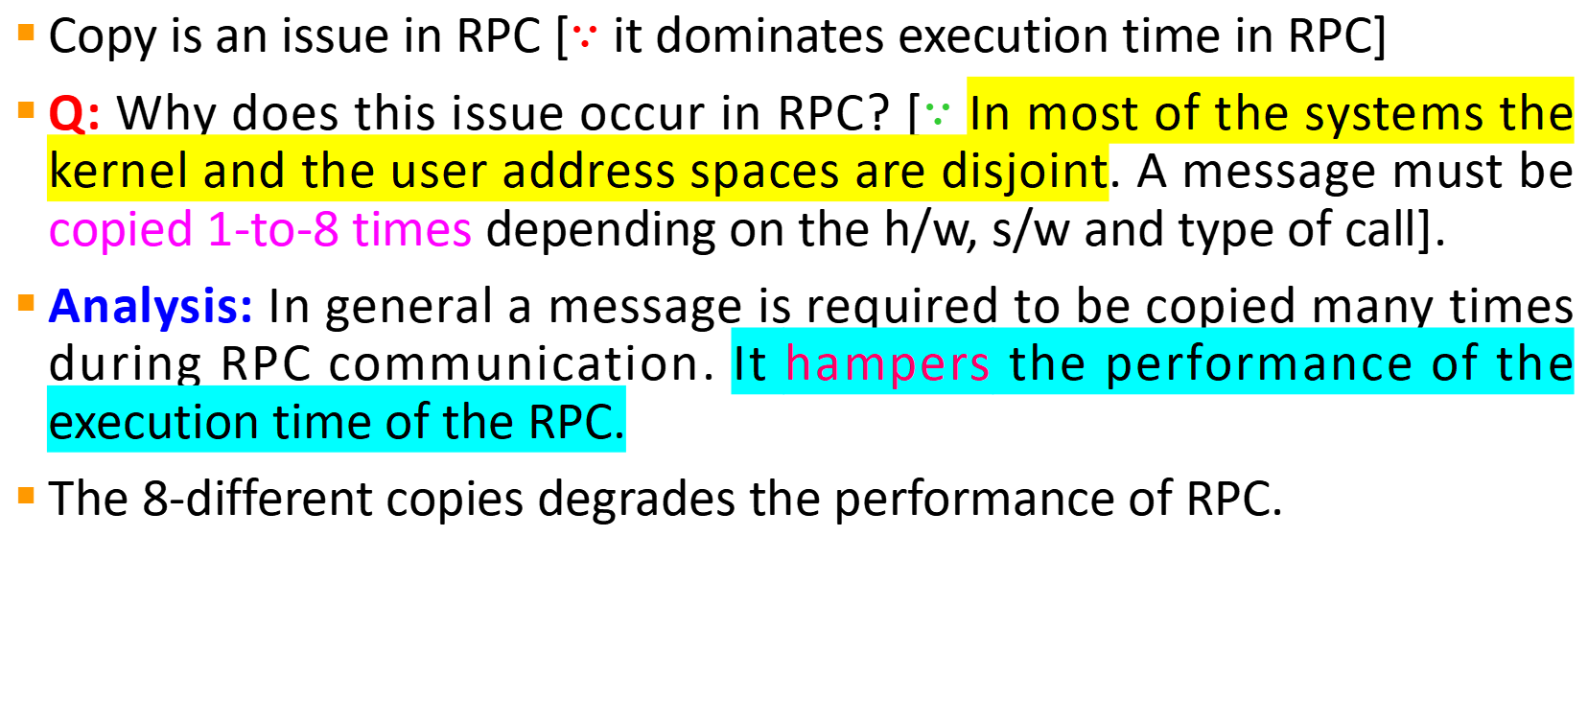
#9.4: Copying
Copy is an issue in RPC [$∵$ it dominates execution time in RPC]
Q: Why does this issue occur in RPC? [$∵$ In most of the systems the kernel and the user address spaces are disjoint. A message must be copied 1-to-8 times depending on the h/w, s/w and type of call].
Analysis: In general a message is required to be copied many times during RPC communication. It hampers the performance of the execution time of the RPC.
The 8-different copies degrades the performance of RPC.

Slide 34
The network chip can DMA the message directly out of the client stub’s address space onto the network, depositing it in the server’s kernel memory.
Then the server kernel inspects the packet and maps the page into the server’s address space. If kernel can’t map the page into the server’s address space, then kernel copies the packet to the server stub
The hardware is started, causing the packet to be moved over the network to the interface board on the destination machine
When the packet arrived, interrupt occurs, kernel copies it to its buffer (before knowing its exact loaction)
Finally, the message has to be copied to the server stub
If(the call has a large array passed as a value parameter) the array has to be copied onto the client’s stack for the call stub,
Copy from the stack to the message buffer during marshaling within the client stub
Copy from the incoming message in the server stub to the server’s stack preceding the call to the server.
Copy
1
MANDATORY
COPIES
Copy
2
Copy
3
8 copies
Copy
4
Performance degrades
Copy
5
Copy
6
Copy
7
Copy
8

Slide 35
#9.4: Copying Cont.
How to eliminate unnecessary copying?
Using the hardware scatter-gather.
A N/W chip that can do scatter-gather can be set up to assemble a packet by concatenating two or more memory buffers.
At the Sender’s side: The kernel can built the reusable packet header inside the kernel space, leaving the user data in client stub, with the hardware pulling them together as the packet goes out the door. Being able to gather up a packet from multiple sources eliminates copying.
At the Receiver’s side: Similiarly, being able to scatter the header and body of an incoming packet into different buffers also helps on the receiving end.
In Operating Systems: Using virtual memory
Using mapping: If(memory map can be updated in less time)
Then, mapping is faster than copying
Else, Not
*****

Slide 36
#9.5: Timer Management
Timer: It is an automatic mechanism for activating an entity at a preset time.
Setting a timer requires building a data structure specifying when the timer is to expire and what is to be done when that happens.
The list of messages are in sorted order
Timer starts just after message transmitted
If(ACK or Reply arrives before the timer expires)
Then the timeout entry must be located and removed from the list
Timer value should be neither too high or too low
Most systems maintains a Process Table to implement Timer

Slide 37
#9.5: Timer Management via Sorted List and Process Table
Current time
Current time
14200
14200
Explanation: In process table instead of storing timeouts in a sorted linked list, each process table entry has a field for holding its timeouts.
Working Principle: The kernel scans the entire process table, checks each timer value against the current time. If (T_{read}<=T_{current}) then it is processed and reset.
Note: Sweep Algorithms operates by periodically making a sequential pass through a process table.
*
Timer is off
14205
Process 3
0
14216
Sorted List w.r.t.
time out
1
0
14212
Process 2
2
14212
14216
Process 0
3
14205
0
(a) Timeouts in a sorted list
(b) Timeouts in a process table

Slide 38
Q&A

Slide 39
Practice Questions
How an Operating System avoid copy of a message during RPC? (Pg-93)
Suppose that the time to do a null RPC (i.e., 0 data bytes) is 1.0 msec, with an additional 1.5 msec for every 1K of data. How long does it take to read 32K from the file server in a single 32K RPC? How about as 32 1K RPCs? (Pg. 117)

Slide 40
Thank You!

